Slide 1
SuperVISOR MEETING
G4-T6: SHU WEI, WU WEI, JASON, YONG SIANG, JEREMY(PM)

Slide 2
SHOWING OF SCHEDULE
PPLOG http://green.smu.edu.sg/pplog/pplog
EXCEL SPREAD SHEET https://docs.google.com/spreadsheets/d/1P0F2HUwb5Ivx159Hok0d46xO-6j0EO53ucDJ27sdrq8/edit#gid=0

Slide 3
Progress for the past two weeks
Conducted Peer teaching/help (Did Labs and attended enrichment together)
Documentation
Scheduling(All iterations)
Test plan
Diagrams
Use Case, Class diagram, SD(login, bootstrap), LD
Create test cases for login& bootstrap
Coding
Developed login function
Prepare for SM & PM Review

Slide 4
deviation from the planned schedule?
We are right on schedule!
Notes:
Be specific! Tell us the number of days you are ahead/behind schedule. Not some vague answers ("somewhat behind schedule").

Slide 5
Goal(s) for the coming two weeks and immediate milestone.
GOALS:
Finish relevant documentation(Test case, Metric tracking, diagrams(SD, Class diagram))
Develop functionalities:
Bootstrap(Week 7)
Basic App Usage report(Week 7,8)
Top-K App Usage report(Week 7,8)
Smartphone overuse Report(Week 8)
Justification of goals:
Recess week(More meetings-4 times that week)
Overall group schedule relatively free
Difficulty of functionality(relatively more manageable as compared to later features)
MILESTONES:
Week 6: Supervisor Meeting(25th Sep)
Week 7: PM Review(1st Oct)

Slide 6
Any problems?
Existing:
Unsure with a lot of functionalities (new to it)
Cannot give accurate estimate
A lot of diagrams are uncertain
Potential(Foreseeable):
Stuck with certain functionality development
Solution:
Conduct self research before & during development(GOOGLE , GOOGLE, GOOGLE!!!)
Seek help from groupmates, peers from other groups, TA
OT if required
Notes:
Any problems (existing or potential) that threaten the successful, on-time completion of your project.

Slide 7
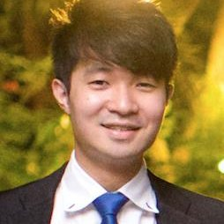
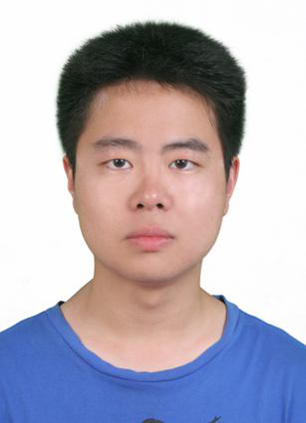

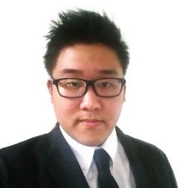
Who did what?
YONG SIANG:
-Conducted Peer teaching
-Discussed Scheduling
-Discussed diagrams (Use Case, Class diagram, Login SD)
-Develop login functionality
-Prepare for SM & PM Review
-Develop LD
-Take Minutes
WU WEI:
-Participated in Peer learning
-Discussed Scheduling
-Discussed diagrams & functionality (Use Case, Class diagram, Login SD)
-Take charge of PM discussion -Take Minutes
SHU WEI:
-Conducted Peer teaching
-Discussed Scheduling
-Discussed diagrams& functionality (Use Case, Class diagram, Login SD)
-Prepare for SM & PM Review -Take Minutes
JASON:
-Participated in Peer learning
-Discussed Scheduling -Discussed diagrams (Use Case, Class diagram, Login SD)
-Test plan -Test case (login)
-Develop login functionality
-Prepare for SM & PM Review -Take Minutes
JEREMY(PM):
-Participated in Peer learning
-Take charge of scheduling
-Discussed diagrams & functionality (Use Case, Class diagram, Login SD)
-Take charge of SM discussion -Take Minutes
Notes:
Make sure you have your latest build on the deployment server and ready to demo. Source code checked out to your laptop and be ready to explain your codes.

Slide 8
Bug metrics
ITERATION | S/N | FUNCTION | DESCRIPTION | CAUSE | CORRECTION MADE | SEVERITY | DATE FOUND | DATE SOLVED
SEVERITY
Low impact(1 point) Unimportant. Typo error or small user interface alignment issues.
High impact(5 point) The system runs. However, some non-critical functionalities are not working
Critical impact(10 point) The system is down or is un-usable after a short period of time. We have to fix the bugs to continue.
FORMULAE: 1 x num (low) + 5 x num (high) + 10 x num (critical)
TOTAL SCORE:
Notes:
Show evidence of tracking. Note: the pplog software only computes the metric numbers for your schedule metrics. You still need to show us evidence of tracking and using (i.e., you looked at the number and did the right mitigation) the metric values. You also need to show us your tracking, and actions taken for your bug metric

Slide 9
SCHEDULE METRICS(PPlog)
Iteration Schedule Metrics
Iteration | % Completion | Estimated Days | Actual Days | Schedule Metric | Action
1 | 80% | 14 |  |  | No action required
2
3
4
5

Slide 10
PAIR PROGRAMING METRICS(pplog)

Slide 11



Mitigation plan
PAIR PROGRAMMING METRICS :
<50 -Increase time allocated to tasks in the next iteration (Need more time) -Review possible paring & estimation issues -OT to make up
50-150
Go on with PP, no change
>150
-Decrease time allocated to tasks in the next iteration (Overestimate) -Review possible paring & estimation issues
SCHEDULE METRICS:
<90 -Inform supervisor within 24 hrs -Too slow/not finishing on schedule -OT to make up
90-110 Go on with Schedule, no change
>110 -Include more task in the next iteration (Overestimated time taken) -Add number of days gain to buffer
BUG METRICS:
<10 Use planned debugging time in the iteration
>10 Stop development and resolve the bug immediately PM reschedules the project

